Slide 1
D23 Capital & Advisory Intro &
$300m Volpara Sale Case Study
March 2024
Highly Confidential

Slide 2
Important Notice & Disclaimer
Confidential
This confidential document (which includes any schedules, attachments, appendices and/or any supplemental material and associated oral briefings) ('Document) is being provided to L1 by D23 Capital & Advisory (together with its related bodies corporates and its affiliates, "D23") in connection with the a potential M&A advisory assignment (the "Financial Advisory Assignment") and may not be used or relied upon for any purpose other than as specifically contemplated under a separate written agreement with D23. This Document is for the benefit of the Company only and may not be relied upon by any other person. This Document may not be disclosed, in whole or in part, summarised or otherwise referred to except as agreed in writing with D23.
No verification
The information and assumptions used in preparing this Document were obtained from financial information and forecasts supplied by the Company and/or its representatives, Bloomberg, FactSet, Broker Research and other public sources. D23 has not conducted due diligence or independently verified the information provided by the Company and/or its representatives and assumes no responsibility for independent verification of such information and has relied on such information being complete, up-to-date and accurate in all respects.
The information contained in this Document is indicative and preliminary in nature and is subject to further due diligence and review. D23, its directors, officers, employees and advisers (1) make no warranty or representation as to the accuracy or completeness of the information in this Document, (2) assume no obligation to update or otherwise revise the information contained in this Document, and (3) exclude and declaim ail liability, except as may not be excluded by law, for any expenses, losses (including consequential losses), damages or costs that may be incurred by you or any other party as a result of that information being inaccurate or incomplete in any way for any reason. By accepting this Document, the Company releases and indemnifies D23, is directors, officers, employees and advisers from and against all claims, actions, damages, remedies or other matters, whether in tort, contract or under law or otherwise, arising from or which may arise from or in connection with the provision of, or any purported reliance on, this Document, and it undertakes that no claim or allegations will be made against such person in relation to this Document.
Forward looking information
To the extent this Document includes estimates, forecasts of future financial performance (including estimates of potential cost savings and synergies) or forward looking statements ("relevant statements") prepared by or reviewed or discussed with management of the Company, the board and/or other potential transaction participants or obtained from public sources, we have assumed that such relevant statements have been reasonably prepared and reflect the best currently available estimates and judgments of management (or, with respect to relevant statements obtained from public sources, represent reasonable estimates). Statements or assumptions in this Document as to future matters may prove to be incorrect. We make no representation or warranty as to the accuracy or completeness of such relevant statements nor may the Document's contents be relied upon as, a representation, whether as to the past, the present or the future.
Things may change
Please note that the actual value of the Company, the business or its various components described in this Document necessarily depends upon conditions as they exist and can be discerned at a particular time and any views on value involve numerous assumptions and uncertainties, many of which cannot be verified or ascertained. The views in this Document are based on economic, financial, market and other conditions as they existed, as well as our experience in similar transaction, and have been evaluated by us as the date of this Document. It should be understood that subsequent developments may affect the views in this Document and we are not obliged to update, revise or reaffirm the Document. Furthermore, the views as to the estimated value of the Company or any other any entity or Company or any other entity or business (whether in whole or part) should not be interpreted as an actual or guaranteed realisable value.
Further advice required
This document is not, nor does it contain, a fairness opinion or represent an independent experts report. This Document is designed solely by the Company in connection with the proposed Financial Advisory Assignment. Where recipients other than the Company have received this confidential Document with or without D23 consent, such recipients acknowledge that (a) use of the Document and the information contained in this Document is entirely at their own risk and they are responsible for performing their own due diligence and independent verification of the information prior to use; (b) the information was prepared solely for the use and benefit of the Company; (c) no recipient nor any other person other than the Company may rely on the information contained in this Document; (d) D23 does not owe any duty of care or fiduciary duty to the recipient or any other person; and (e) D23 excludes and disclaims all liability to the recipient in relation to the information, except as may not be excluded by law.
Nothing contained in this Document should be construed as tax, accounting or legal advice. While these materials may contain recommendations on certain matters or actions, given the Iimited information on which it was prepared, it does not purport to take into account all information or considerations that you may need before making a decision concerning those matters or actions. Any tax statement herein regarding any U.S. federal tax is not intended or written to be used, and cannot be used, by any taxpayer for the purpose of avoiding any penalties. Each taxpayer should seek advice based on the taxpayer's particular circumstances from an independent tax advisor. You (and each of your employees, representatives or other agents) may disclose to any and all persons, without imitation of any kind, the tax treatment and tax structure of the transactions contemplated by these materials and all materials of any kind (including opinions or other tax analyses) that are provided to you relating to such tax treatment and structure. For this purpose, the tax treatment of a transaction is the purported or claimed U.S. federal income tax treatment of the transaction and the tax structure of a transaction is any fact that may be relevant to understanding the purported or claimed U.S. federal income tax treatment of the transaction.
Not a fiduciary
No fiduciary relationship between the Company and D23 has been created in respect of D23's provision of this Document, regardless of whether D23 has advised or is advising the Company on other matters and D23 is acting as independent contractor and not in any other capacity. The Company acknowledges that D23 is involved in a wide range of commercial barking and investment banking activities globally and may currently, or in the future, act in various roles including as underwriter, dealer, broker, lender or financial advisor to entities from which conflicting interests or duties may arise, and it waives any claims it may have, insofar as such claims are based on any actual or potential conflicts of interest that arise out of or relate to D23 engaging in the activities as described above.
These materials have also been prepared by D23 for use by D23 and is affiliates. Accordingly, any information reflected or incorporated herein, or in related materials or in ensuing transaction, may be shared in good faith by D23 and their affiliates with employees of D23, their affiliates, agents and contractors in any location.
Disclaimer
Neither D23, nor any of its directors, officers, and employees, nor any of its related bodies corporate and its respective directors, officers, and employees (collectively, the "Parties") warrant or represent the origin, validity, accuracy, completeness or reliability of or accept any responsibility for errors in or omissions from any information or any consequential errors in or omissions from this Document or any accompanying information (whether oral or written). To the extent permitted by law, the Parties disclaim and exclude all liability for any losses (including economic and / or consequential losses), claims, damages, demands, costs, and expenses of whatever nature arising in any way from or in connection with the information contained in this Document, the provision of this Document (or any accompanying or other information), and any inaccuracy, incompleteness, or any use or reliance by any person on any such information or this Document.

Slide 3
Introduction to
D23 Capital & Advisory

Slide 4
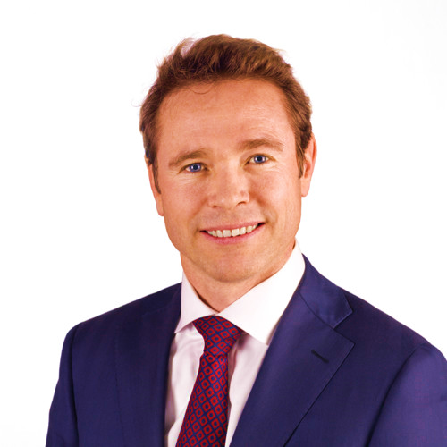
D23 Overview
D23 is a boutique investment bank specializing in the ANZ technology and growth ecosystem, providing unique access to buyers and investors in the USA, Europe, and Asia
With a focus on delivering tier one, bulge bracket investment banking experience and services, D23 offers connectivity between ANZ / offshore markets without the conflicts and costs associated with global banks
Our team of 5 with global technology banking experience overcome the issues associated with the ‘concierge effort’ of local Australian bulge bracket technology bankers with limited understanding of / experience in technology, relying on their o/s colleagues who often deprioritize the Australian mandate / client / deal (often due to size), resulting in poor service, execution and results
We offer unrivalled understanding of business models, trends, required metrics and how to position them, combined with direct relationships and access to buyers and funding partners around the world
We are the only Technology focused investment banking boutique in Australia / NZ that can truly offer all equity, debt and M&A services for public and private companies, large and small
James Disney
Founder / CEO
james@d23capital.com
+61 417 885 885

Slide 5

James Disney – Co-Head of Investment Banking
2018 – 2023
Sydney, Australia
James Disney (Credentials)
Selected M&A transactions:
Selected Financing transactions:
Co-head Investment Banking
& Capital Markets
Vice Chairman of Investment Banking & Capital Markets
Head of TMT
Head of Private Equity
Coca Cola European Partners $10bn Acquisition of Coca Cola Amatil
AMP $6.4bn Defence Advisor and AMP Capital Spinoff
Link Market Services $4bn Acquisition by Carlyle / Pacific Equity (withdrawn)
Blackstone $4bn Buyside Public Tech Company
TradeMe $2.6bn acquisition by Apax
iNova ~$2.5bn Sale of Majority Stake for Carlyle / PEP to TPG
AdBri $2bn Defence and Asset Sales
Blackstone ~$2bn Buyside Public Tech Company
Pushpay $1.5bn Buyside for Reverence Capital Partners / Ministry Brands (ongoing)
Greencross $1bn acquisition by TPG
Hoyts $700m Sellside for Wanda
Hellers $700m Sellside for Adamantem (withdrawn)
iNova $600m Buyside for TPG
Diversis Capital $600m Public Company Tech Buyside
Infomedia $600m Defence
CVC Australia $600m Public Company Tech Buyside
Affinity Education $625m sale to Quadrant Capital for Anchorage Capital
Life 360 $300m Acquisition of Tile
Servian $360m Sale to Cognizant for Adamantem Capital
Kathmandu $350m Acquisition of Rip Curl
RM Williams $190m Acquisition by Andrew Forrest / Tattarang
Netwealth $100m Acquisition of SuperHero (withdrawn)
Colonial First State $1.75bn LBO Financing for KKR’s 55% Acquisition from CBA
Ventia $1.6bn Financing for Apollo’s acquisition of Broadspectrum
TradeMe NZ $1.25bn LBO Financing for Apax
MYOB $1.2bn LBO Financing for KKR
Bingo Recycling $1bn LBO Financing for Macquarie Infrastructure Real Asset Fund
TradeMe NZ$1bn Dividend Recap for Apax
Ventia $980m Refinancing for Apollo
Greencross $660m LBO Financing for TPG
Pepper Money $500m IPO for KKR
Cedar Pacific $450m Equity Private Placement
Ticketek $435m LBO Financing for Silver Lake
WebJet $346m Seconardary Equity Financing
Kathmandu $375m Senior Acquisition Financing
Judo Bank $350m and $250m Asset Backed Securitisation Facilities
Xero $300m Equity Block Trades
Carsales Korea $300m IPO
Life 360 $300m US IPO
Kathmandu $207m Secondary Equity Financing
Seven Group Holdings $200m Share Backed Loans (Stokes Family Office)
Life 360 $150m IPO
Pepper Global $75m Revolver Facility
Pepper Financial $125m Bridge Facility
Metrics Credit Fund $120m Debt Facility
WiseTech Global $100m Equity Block Trade
Life 360 $90m Placement to Fund Acquisition of Tile
Pepper Financial $75m Bilateral Corporate Facility
Till Payments $70m Private Placement

Slide 6
James Disney – Global Head of Software & Infrastructure
2008 – 2018
New York & San Francisco
James Disney (Credentials)
Selected M&A transactions:
Selected Financing transactions:
Global Head of Software & Infrastructure
Investment Banking
IT Services Banker
Financial Technology Banker
BMC $8.3bn Sale to KKR
SolarWinds $4.5bn Sale to Silver Lake & Thoma Bravo
Ellucian $3.5bn sale to TPG
PowerSchool / PeopleAdmin $2.8bn Acquisition for Vista / Onex
Infor $2.5bn Minority Stake Sale to Koch
Dell Software $2.5bn Acquisition by Francisco Partners / Elliot
Digicert $2.3bn Acquisition by Clearlake & TA Associates
Rocket Software $2.0bn sale to Bain Capital
Aconex A$1.6bn sale to Oracle
Vision / Syncsort $1.3bn acquisition by Centerbridge
Viewpoint’s $1.2bn sale to Trimble
Synchronoss $1.1bn Acquisition & Financing of Intralinks
Telcordia $1.2bn Sale to Ericsson
JDA Software $600m Investment from Blackstone
Paradigm’s $510m sale to Emerson
Quorum’s $310m sale to Silver Lake
Digicert’s Acquisition & Financing of Symantec’s SSL Business
Oracle $14bn bond
IBM $2.8bn Bond
First Data Corporation $2.6bn IPO for KKR
Compuware $2.4bn LBO Financing for Thoma Bravo
Informatica $2.1bn LBO Financing for Permira
Splunk $1.9bn Convertible Bond
Neustar $1.7bn LBO financing for Golden Gate Capital
JDA Software $1.6bn acquisition financing
SolarWinds $1.6bn LBO Financing for Silver Lake & Thoma Bravo
Rocket Software $1.3bn acquisition financings
PowerSchool / PeopleAdmin $1.26bn LBO Financing for Vista / Onex
Hyland Software $700m acquisition financing
Shopify $131m IPO, $658m secondary equity, and $330m secondary equity
Pivotal $638m IPO
Datadog $648m IPO
Travelclick $590m LBO financing for Thoma Bravo
Ceridian $531m IPO and $455m secondary equity
Help Systems $475m LBO financing, and $345m refinancing
Solarwinds $375m IPO
Medallia $374m IPO
2U $119m IPO, $345m and $206m secondary equity
Domo $222m IPO
zscaler $220m IPO
BenefitFocus $200m Convertible Notes
Campaign Monitor $170m LBO financing for Insight Partners
WiseTech Global $168m IPO
Mindbody $123m secondary equity
Everbridge $104m IPO, $127m & $65m equity, $115m Convertible Bond
Alarm.com $115m IPO
Instructure $114m secondary equity
Workiva $100m IPO
Callidus $107m secondary equity
Palantir Direct Listing
Slack Direct Listing

Slide 7
James Disney – Tech Banker
1999 – 2001
Hong Kong
2001 – 2006
San Francisco
2006 – 2008
Sydney, Australia
James Disney (Credentials)
Selected M&A transactions:
Selected Financing transactions:
2006 – 2008
Semiconductor, IT Services Banker
2001 – 2006
Country Head of Technology,
Media Telco Banking
1999 – 2001
Technology Banker
2006 – 2008
PBL Media $6bn Acquisition by CVC from Publishing & Broadcasting Ltd
CVC’s $1.5bn acquisition of 60% of the Stella Group from MFC
2001 – 2006
ChipPAC Sale to ST Assembly & Test for $1.8bn
Conexant Systems Acquisition of GlobespanVirata for $1.1bn
Sale of Memec to Avnet for $676m
Mindspeed $200m Spin-Off from Conexant Systems
2006 – 2008
PBL Media’s (CVC) $600m Unlisted Notes
Emeco’s $950M IPO
BIS Cleanaway’s (KKR) $160m Listed Notes
2001 – 2006
Creditor Selldown of $1.9bn of Hynix Equity
Semiconductor Manufacturing International’s (SMIC) $1.8BN IPO
Spansion $700m IPO
Himax $468m IPO
Spansion $400m High Yield Offering
SiRF Technology $150m IPO
DuPont Photomask $125m Convertible offering
PortalPlayer US$122m IPO
Skyworks Technologies $106m Follow-On Equity offering
1999 – 2001
United Microelectronics (UMC) $1BN Follow-on Equity offering
Siliconware Precision (SPIL) $256M IPO offering

Slide 8
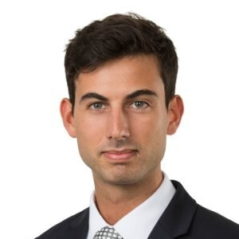
Senior Team
Vasili Hatzis is a Principal at D23 Capital, and joined the firm in 2023
Previously, he was a Vice President with Goldman Sachs, working as a technology investment banker in New York and San Francisco. He started his career in Goldman Sachs’ Sydney office
Whilst in the US, Vasili covered a number of landmark technology clients, and executed high profile transactions across internet, software, fintech, IT services, industrial tech, health tech and media spaces
Key clients included Airbnb, DoorDash, Zoom, Cloudflare, Monday.com, Procore, Pinterest, Coinbase, Coupang, Match, IBM, Unity and Procore, amongst others
He is now bringing this depth of experience to D23’s clients in ANZ, across capital raisings, M&A buyside and sellside processes, and strategic advisory
Vasili Hatzis
Principal
vasili@d23capital.com
+61 413 272 263

Slide 9
Vasili Hatzis
2015 – 2018
Sydney, Australia
2018-2020
San Francisco
2020-2022
New York
Vasili Hatzis (Credentials)
Selected transactions – Internet:
Selected transactions – Software:
2018-2022
US Technology Banker,
Goldman Sachs
2015—2018
Australian Investment Banking, Goldman Sachs
Coupang $4.5bn IPO
Airbnb $3.5bn IPO
DoorDash $3.4bn IPO
Pinterest $1.6bn IPO
Peloton $1.2bn IPO
Doximity $606m IPO
Poshmark $277m IPO
thredUP $168m IPO
Glu Mobile $139m Follow-On
IAC / Match Group $30bn Demerger
eBay Classifieds Strategic Review (sold to Adevinta $9.2bn)
Unity Software $1.3bn IPO
Zoom $864m IPO
Avalara $495m Follow-On
Procore $426m IPO
Monday.com $574m IPO
Cloudflare $525m IPO
ON24 $428m IPO
Jamf $352m Follow-On
Jamf $288m IPO
Jamf $281m Follow-On
KnowBe4 $206m Follow-On
Cision $180m Follow-On
KnowBe4 $152m IPO
Selected transactions – Fintech:
Selected transactions – IT Services, Industrial Tech, Media:
Coinbase Direct Listing
Hippo Insurance deSPAC
Bill.com $1.7bn Dual Tranche FO + Convertible Debt
Bill.com $535m Follow-On
Paycor $426m IPO
Enfusion $261m IPO
Bill.com $216m IPO
IBM / Kyndryl spinoff
Clarivate $1.1bn Follow-On
Clarivate $1bn Follow-On + Mandatory Convertible
Clarivate $745m Follow-On
Clarivate $631m Follow-On
Endeavor $511m IPO
HireRight $420m IPO
Clear Channel Outdoor $350m Follow-On
AMC $350m At-The-Market (ATM) Offering
TaskUs $304m IPO
Xometry $252m IPO
iHeart Nasdaq Uplisting
Innoviz $132m Series C

Slide 10
D23 Case Study - $300m Sale of Volpara (ASX:VHT) to Lunit, Announced 14 / 12 / 2023

Slide 11
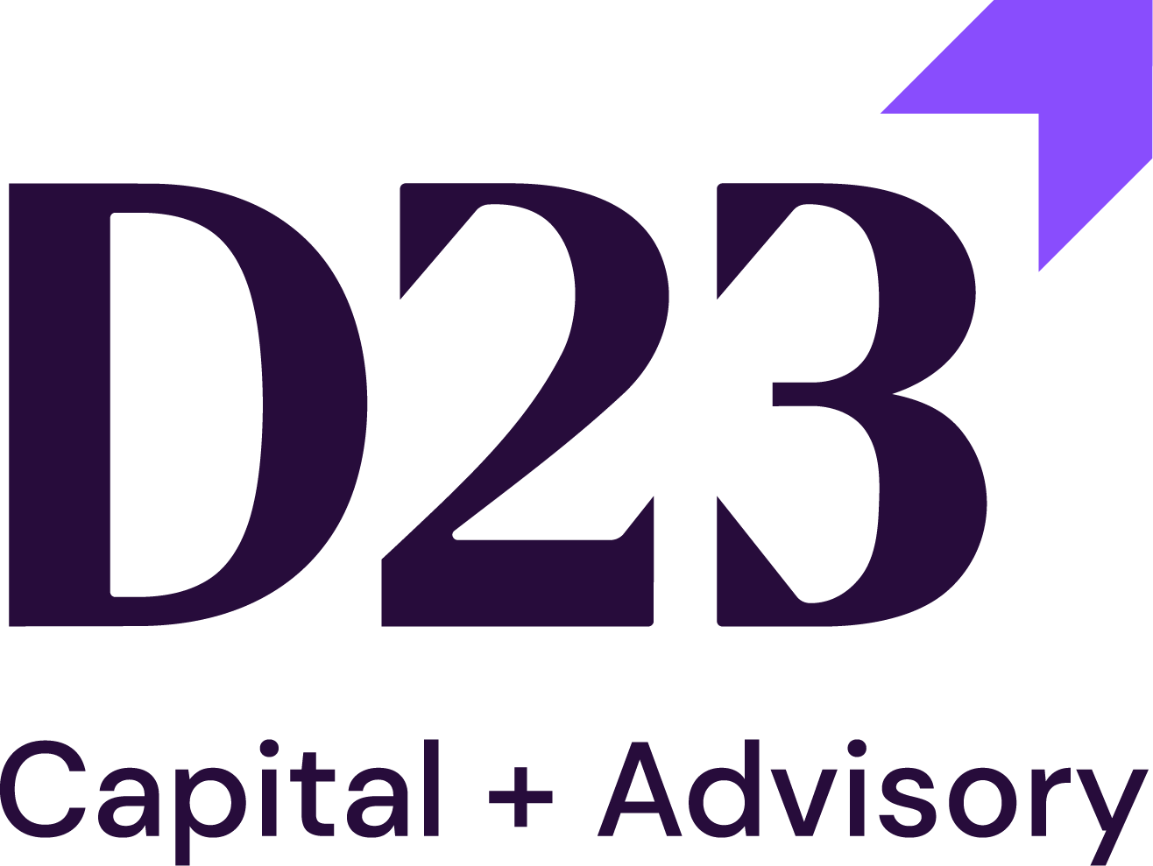
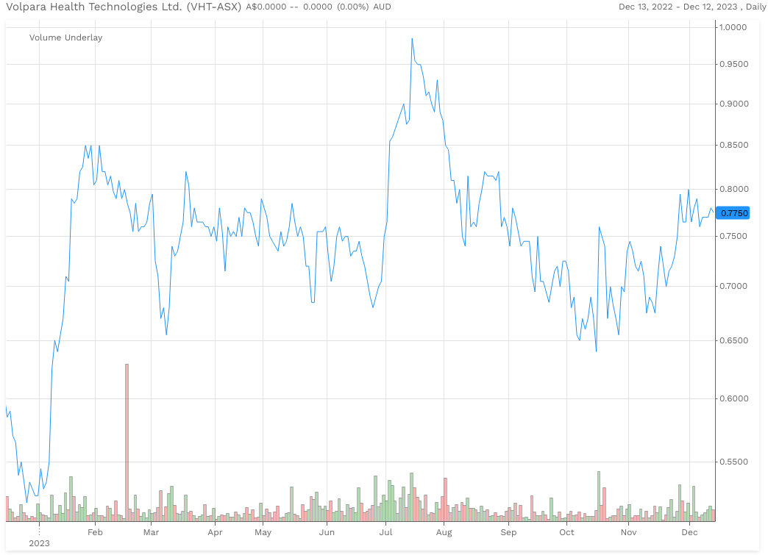
Overview of Volpara – ASX Listed AI SaaS Company
D23 client mandated by Volpara Board in May 2023
SaaS company using AI for Breast Cancer Detection / Prevention
HQ in NZ, ASX listed, 95% USA Revenue
20% Revenue Growth, declining to 17%, EBITDA breakeven
Competitors include Mach7, iCAD, Hologic, Screenpoint, Radnet, Lunit
Pure software company - no hardware / equipment

Slide 12
Volpara / Lunit – M&A Transaction Metrics
Large takeover premium – 33% higher than 5 year ASX takeover average
Attractive Revenue Multiple for breakeven company, with no history of profitability and with declining revenue growth
2 Public companies in complex cross-border deal
Signed Voting Agreements with 3 largest shareholders representing 29% of voting stock, reducing risk of shareholder vote

Slide 13










Customised Transaction Process Delivered Premium Valuation
Global ‘Market Test’
Ran process with seven tier 1 global software Investors – “the board has not authorised a company sale…..”
Multiple Sponsor NBIOs
In-person management meetings in New York, San Fran, Palo Alto and London
3 month process – “no timeline, as this is not a sale process, so no deadlines”
Generated multiple indicative offers – did not initially go to strategics / competitors
Approached Strategics Next
Approached 3 largest competitors – received 1 bid, achieved a 2nd higher revised bid due to competitive tension prior to granting exclusivity, Lunit ultimately bid 45% more than next highest bid
Wall Crossed 3 Largest Investors, Securing 27% of Vote
Negotiated away all conditionality and price adjustments 1) no financing condition, 2) no anti-trust condition, 3) no price adjustment due to cash / debt / dilutive securities / working capital
Wall crossed 3 largest shareholders under NDA and secured voting agreements prior to announcement, representing 29% of shares – shareholder vote has high chance of success

Slide 14


Technology M&A – Lessons Learnt for 2024 from
Sponsors
Strategics
Tech sponsors focus on Rule of 40 has increased
Pivoting to M&A to fill gaps created by R&D / S&M cuts
1
5
Sponsors perform full P&L reconstruction for ANZ co’s
Focus on LTV & CAC – need to show investors model efficiency
2
6
Investment Committees in USA / Europe more cautious than in APAC
Public acquiror’s cornerstone shareholders want to fund M&A
3
7
Ability / Management commitment to take out cost critical – with/w-out more M&A
Boards are significantly more nervous than Management
4
8

Slide 15












Technology Boards & CEOs Key Concerns –
2023 Summary / 2024 Outlook
Against a backdrop of volatile capital / macro / geopolitical / technology markets, what are boards and CEO's thinking about into 2024?
WHAT DRIVES SOFTWARE RESILIENCE IN A DOWNTURN?
HOW TO BALANCE GROWTH WITH PROFITABILITY / RULE OF 40
HOW LONG WILL CLOUD OPTIMISATIONS LAST?
WHAT WILL BE THE IMPACT OF GENERATIVE AI AND LLMS?
WILL THE RECENT US IPOS SIGNAL A BROADER MARKET REOPENING?
WHAT IS THE IDEAL PROFILE OF COMPANIES LOOKING TO RAISE CAPITAL TODAY?
IS IT MORE ADVANTAGEOUS TO BE PUBLIC OR PRIVATE IN THIS ENVIRONMENT?
WHEN WILL STRATEGIC ACQUIRORS BECOME ACTIVE AGAIN?
WILL SPONSORS / PRIVATE EQUITY REMAIN ACTIVE IN SOFTWARE?
SOFTWARE ACTIVISIM HAS EMERGED - WILL IT CONTINUE?
HOW TO THINK ABOUT CAPITAL ALLOCATION IN THE NEW RATE ENVIRONMENT
WHAT IS STOCK BASED COMP'S IMPACT ON DILUTION & VALUATION?

Slide 16
ANZ Tech Market Update

Slide 17
Executive Summary
ANZ IT has outperformed the broader tech sector in recent months, driven by listed IT companies' profitability and investor preference for strong cashflow over burn rates
Public market valuations have been steadily improving in recent months, however, tech valuations are still trading well below long-term averages
1
4
M&A activity has declined in both value and volume year-over-year; however, the mid-market segment remains resilient
Despite ASX awaiting its second tech listing in nearly 2 years, secondary and private offerings continue at reasonable rates compared to pre-pandemic times
2
5
Ongoing transactions involving X Team, Versent, Lab3, and Fusion5 highlight a resurgence in investor interest in ANZ IT Services sector
Shifts in sector popularity, Climate / CleanTech topped in Q3’23 as most funded and highest deal count lists
3
6

Slide 18
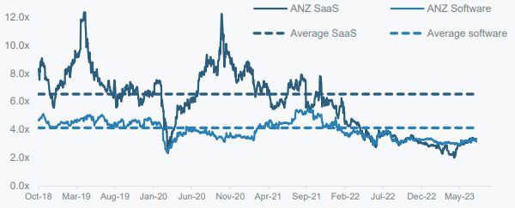
Key Market Themes
1
The listed Australian technology sector has rallied strongly in recent months outpacing the broader market indices
ASX 200 IT has shown resilience outpacing its global counterparts, has grown ~21% over the past 1 months
SaaS and E-commerce leads the listed ANZ Tech space growing at median 27%+ and ~55%+; Software remains flattish
Interest rates at / near peak; potential for 'immaculate disinflation’ or ‘soft landing’ - normalizing inflation without significant unemployment or economic downturn
Market
Overview
2
Market
Valuations
Public market have valuations improved recently as ‘risk-on’ rate fuelled rally continues
The IT sector outpaced broader tech gains in recent months, driven by listed IT companies' profitability and investor preference for cashflow over burn
ANZ Software valuations have improved steadily driven by the profitability but still below the long-term averages
ANZ SaaS
ANZ Software
Avg. SaaS
Avg. Software
Nov-23
Source: Bloomberg, Globalnewswire and Press Releases.

Slide 19
Key Market Themes (Cont’d)
3
M&A Activity
M&A deal values and volumes have decreased compared to the previous year. However, M&A deal activity in the mid-market is showing resilience
Notable, large reported transactions underway include X Team, Versent, Lab3 and Fusion5. Good results in these will bode well for the rest of the market
Select Transactions:
  Versent sold to Telstra for 20x LTM EBITDA and 14x NTM EBITDA of $14m (fully loaded ebitda)
  ⁠BGH in final stages of Fusion 5 acquisition in NZ - unlikely to merge with Cyber CX
  Attura (ASX: ATA) completed several legacy acquisitions of low quality and raised equity capital on the ASX
  ⁠VITG sale process launched in early stages (no management meetings held yet)
  ⁠Lab 3 trying to raise private capital of $5-15m
  Five V owned Mantel Group and EQT owned Nexon will likely sell in CY2024
4
Funding Report
Mega deals remain elusive in Q3’23, however, Employment Hero funding $167mm boosted muted investor sentiment
Sub-$5M funding rounds plummeted to 2019 levels. However, total announced funding in 2023 grew 42% compared to the same period in 2022 driven by smaller internal rounds
Venture debt resurges, offering founders & advisors an array of strategies navigating the seed-to-scaleup lifecycle and beyond
Clean Tech and Climate tech, E-commerce, Enterprise Software, IoT lead the overall tech sector funding
Source: Bloomberg, Globalnewswire and Press Releases.

Slide 20
Key Market Themes (Cont’d)
5
Cashflow and Earning Focus
Many cash-burning tech companies remain unloved, especially those affected by higher interest rates and their impact on lending volumes and loan impairments
Investors remain highly sensitive to companies burning cash and without a near term plan to move to positive cashflow
The number of investors willing to support high-growth, high-cash-burn ventures has decreased, and those who remain tend to be more cautious about valuations
6
Big M&A Waves
in IT Services
There has also been a significant amount of corporate M&A and consolidation in the ANZ IT Services space in recent years.
Smaller companies (>$3 mil revenue) are often absorbed into larger players as a scale play or to tap into new customer bases so that they can cross sell existing services to that niche
Atturra has been aggressively trying to grow inorganically via M&A – acquisitions are all of low quality
Source: Bloomberg, Globalnewswire and Press Releases.

Slide 21
ANZ Tech Market Update – Public Company Valuations

Slide 22
Broader Australian Tech Market Indices at a Glance
The listed indices have recovered but witnessed correction over the past month on the back of global rate question marks
Share Prices are Rebased to 100
Return Period | ASX All Tech | ASX 200 | ASX 200 IT
1M | (1.4%) | (3.4%) | (1.7%)
2M | 10.1% | 6.7% | 9.6%
3M | 16.2% | 12.2% | 15.8%
6M | 3.1% | (1.3%) | (6.1%)
12M | 16.2% | (6.6%) | 18.8%
Source: Bloomberg. Market data as of 18th January 2024.

Slide 23
LTM “D23 Tech Index” Performance
The listed indices have recovered and are continuing to rise, with the ASX 200 IT performing strongly since the start the Q2’23
Share Prices are Rebased to 100
Return Period | SaaS | Software | Fintech | Tech H&E and Online Classifieds | Tech Enabled IT | Marketplace | E-commerce | IT Services and Cloud Infra
1M | (11.9%) | (5.3%) | 2.0% | (3.0%) | 1.1% | 5.9% | (5.3%) | 3.6%
2M | 21.1% | 4.4% | 11.2% | 14.4% | (0.9%) | 1.1% | 34.8% | 16.7%
3M | 34.7% | 13.0% | 16.7% | 27.9% | 5.1% | 13.9% | 63.6% | 22.8%
6M | 19.1% | (4.0%) | (13.8% | 25.3% | (39.8%) | (10.4%) | 31.5% | 7.3%
12M | 12.4% | (5.6%) | (27.3%) | 45.0% | (56.0%) | (22.5%) | 58.0% | 10.2%
Source: Bloomberg. Market data as of 18th January 2024.
Note: SaaS: BigTinCan, Damstra, Eroad, Infomedia, Janison, Jumbo Interactive, Life360, Nuix, PEXA Group, Serko, ReadyTech, Volpara, Task Group, Whispir, Xero. Software Pure-Play: Altium, Bravura, Envirosuite, FINEOS, Gentrack, Hansen, Iress, Objective, Praemium, RPM Global, Smart Parking, TechnologyOne, Vista Group. Fintech: EML, Hub24, Humm, Solvar, MoneyMe, OFX, Raiz, Smartpay, Tyro. Tech H&E (Hardware & Equipment) and Online Classifieds: Codan, Audinate, carsales.com, Domain, SEEK. Tech Enabled IT: Aerometrex, Appen, DUG technology, Straker. Marketplace: Airtasker, Freelancer, Hipages, Redbubble. E-commerce: Kogan, StepOne Clothing, Temple & Webster. IT Services and Cloud Infra: COSOL, Data#3, Megaport, NextDC, Superloop.

Slide 24
ANZ Tech M&A Snapshot – Last 5 Years
Strategics Lead M&A in ANZ Tech Space; Vertical Applications and Enterprise Resource Planning Remain Most Targeted
ANZ Tech M&A Disclosed Deal Value ($bn)
Deal Volume by Top Target Primary Sectors 2023 (#)
ANZ Tech M&A Deal Volume (# Transactions)
Top Buyers TTM 2023 (# Deals)
Anchorage Capital Partners

Slide 25






























ASX Take Private M&A Activity Across Technology Sector
Offer Date | Target | Description | Buyers | Deal Status | EV/LTM Revenue | EV/LTM EBITDA | Revenue Growth | EBITDA Margin | FCF Margin
Dec-23 |  | AI Cancer Diagnosis |  | Pending | 7.5x | -- | -- | -- | --
Jun-23 |  | Cybersecurity services |  | Closed | 1.3x | -- | 1.5% | (13.7%) | (19.7%)
Jun-23 |  | Employee well-being platform |  | Closed | 1.7x | 11.2x | 40.6% | 10.7% | 3.3%
Dec-22 |  | Sales enablement |  | Withdrawn | 3.7x | -- | 13.0% | 3.8% | (19.2%)
Nov-22 |  | SaaS for sports / leisure / hospitality |  | Closed | 5.1x | -- | 31.4% | (16.5%) | (62.8%)
Nov-22 |  | Cloud HR / HCM |  | Closed | 3.6x | 23.0x | 37.4% | 15.6% | 14.2%
Oct-22 |  | Fintech / Payments |  | Withdrawn | 4.9x | -- | 32.3% | 7.8% | (42.4%)
Sep-22 |  | Digital workflow |  | Closed | 2.2x | -- | 36.2% | 3.3% | (15.2%)
Aug-22 |  | Mapping Software |  | Closed | 7.5x | 43.6x | 22.4% | 16.1% | 2.8%
Jun-22 |  | Payroll and HCM |  | Closed | 3.5x | 31.9x | 74.1% | 11.0% | (11.0%)
May-22 |  | AI Data Consulting |  | Withdrawn | 6.1x | 11.8x | 5.5% | 53.1% | 18.8%
May-22 |  | Donor management |  | Closed | 6.6x | 21.3x | 13.3% | 30.8% | 30.1%
May-22 |  | Automotive parts |  | Withdrawn | 4.9x | 38.1x | 8.4% | 17.4% | 6.9%
Oct-21 |  | SMSF software |  | Closed | 7.4x | 18.6x | 24.5% | 39.9% | 19.3%
Sep-21 |  | Billings System Software |  | Withdrawn | 12.7x | 21.9x | 2.1% | 39.1% | 24.8%
Jun-21 |  | Cloud IT Consulting |  | Withdrawn | 29.9x | -- | (3.7%) | 33.8% | 21.0%
Jun-21 |  | Financial services software |  | Withdrawn | 6.1x | 25.4x | 2.2% | 23.9% | 23.6%
Jun-21 |  | Engineering Design |  | Closed | 4.9x | 19.8x | 19.7% | 24.8% | 25.7%
Median |  |  |  |  | 4.9x | 21.9x | 19.7% | 16.1% | 6.9%
Source: Capital IQ, company filings

Slide 26











ANZ Tech: Select Secondary Capital Raisings (1/2)
Raising Date | Target | Category | Use of Proceeds | Market Cap ($mm) | Raising Size ($mm) | Premium (Discount) to last close
Aug-22 |  | Software | Working Capital | 48.3 | 6.4 | (21.3%)
Aug-22 |  | Communication Equipment | Working Capital | 27.4 | 10.6 | (50.0%)
Aug-22 |  | Technology Distributors | Working Capital | 1,233.2 | 45.2 | (10.3%)
Dec-22 |  | IT Consulting | M&A | 121.0 | 15.7 | 2.4%
Dec-22 |  | Application Software | Working Capital | 250.6 | 18.9 | (16.7%)
Feb-23 |  | Technology H&E | Product Development / R&D | 386.8 | 75.6 | (21.1%)
Mar-23 |  | Software | Working Capital | 133.0 | 50.4 | (52.9%)
Mar-23 |  | SaaS | Repayment of Debt / Working Capital | 107.8 | 12.6 | (14.3%)
Mar-23 |  | Technology H&E | Product Development / Working Capital | 63.8 | 6.4 | (20.0%)
Apr-23 |  | Technology H&E | Product Development / Working Capital | 759.2 | 37.8 | (9.7%)
May-23 |  | Internet Services & Infrastructure | General Corporate / Working Capital | 3,351.5 | 389.3 | (8.3%)
May-23 |  | Tech Enabled Services | Working Capital | 279.8 | 37.5 | (19.6%)
Jun-23 |  | Infrastructure / Cloud | Working Capital | 813.3 | 100.8 | (7.6%)
Median |  |  |  |  | 37.5 | (16.7%)
Source: Capital IQ, company filings

Slide 27














ANZ Tech: Secondary Capital Raisings (2/2)
Raising Date | Company | Investors | Raising Size ($mm)
Sep-22 |  | Acorn Capital; ANU Connect Ventures; Lockheed Martin Ventures; Moelis Australia Asset Management; Powerhouse Ventures; Significant Capital VC | 26.5
Sep-22 |  | Carthona Capital; Fire V Capital | 9.4
Sep-22 |  | Centerstone Capital | 9.7
Jan-23 |  | Jesselson Capital; Entrée Capital Limited; Aleph Venture Capital; Ocean Azul Partners; Digital Horizon; SeedIL Ventures | 9.9
Jan-23 |  | NA | 31.6
Jan-23 |  | AirTree Ventures; Icehouse Ventures; Left Lane Capital; Athletic Ventures | 22.1
Feb-23 |  | CM Equity Partners; Rampersand; Investible; MA Financial Group; CSIRO Financial Services; Jelix Ventures; Ultratech Capital Partners; Breakthrough Victoria; MA Growth Ventures | 16.4
Feb-23 |  | 1835i Ventures; Deutsche Bank; Fifth Estate; NAB Ventures; Peregrine; Wunala Capital | --
Mar-23 |  | Macquarie Capital, Liverpool Partners – part of $150m financing, on approx. $170m of Revenue, 21% growth, 3 main practices - digital networks, cyber security and cloud computing. Key customers include Australia Post, Zenitas, Flight Centre and QBE. Orro is a roll-up – failed 2022 sale process | 94.5
Apr-23 |  | Acorn capital | 28.5
May-23 |  | AirTree Ventures; Greylock; Insight Venture Management; Madrona Venture Group; Salesforce Ventures; SoftBank Investment Advisers | 27.8
May-23 |  | AirTree Ventures Pty. Limited ; Great Southern Bancorp, Inc. (NasdaqGS:GSBC) ; Square Peg Capital Pty | 30.2
Mar-23 |  | Deer Management; Blackbird; Data collective; Promus Venture Management; Icehouse Ventures | 49.8
Apr-23 |  | Artesian Capital Management (Australia) Pty. Ltd.; Ten Eleven Ventures; CSIRO Financial Services Pty. Ltd. | 18.9
Source: Capital IQ, company filings

Slide 28


























Valuation Multiples (1/2)
SaaS
Software Pure-Play
24E Revenue
Median: 2.5x
Median: 2.9x
25E Revenue
Median: 2.6x
Median: 2.8x
26E Revenue
Median: 2.4x
Median: 2.5x
Infomedia
Source: Bloomberg,.
Note: (1) Data as of 18th January 2024.

Slide 29
Valuation Multiples (2/2)
FinTech
Tech H&E / Classifieds
Tech
Enabled
IT
BPO
SaaS
Software Pure-Play
24E EBITDA
Median: 9.6x
Median: 19.7x
25E EBITDA
Median: 8.3x
Median: 13.3x
26E EBITDA
Median: 7.9x
Median: 10.8x
Infomedia
Source: Bloomberg,.
Note: (1) Data as of 18th January 2024.

Slide 30



















Valuation Multiples (1/2)
Fintech
Tech H&E and Online Classifieds
Tech Enabled IT
Marketplace
E-commerce
IT Services & Cloud Infra
24E Revenue
Median: 3.1x
Median: 9.7x
Median: 0.5x
Median: 1.5x
Median: 1.8x
Median: 1.5x
25E Revenue
Median: 2.7x
Median: 8.8x
Median: 0.4x
Median: 1.2x
Median: 1.5x
Median: 1.4x
26E Revenue
Median: 2.3x
Median: 7.7x
Median: 1.2x
Median: 1.1x
Median: 1.2x
Median: 1.3x

Slide 31
Valuation Multiples (2/2)
FinTech
Tech H&E / Classifieds
Tech
Enabled
IT
BPO
Fintech
Tech H&E and Online Classifieds
Tech Enabled IT
Marketplace
E-commerce
IT Services & Cloud Infra
24E EBITDA
Median: 8.5x
Median: 19.4x
Median: 6.1x
Median: 10.8x
Median: 10.5x
Median: 14.2x
25E EBITDA
Median: 7.2x
Median: 17.2x
Median: 4.4x
Median: 7.2x
Median: 9.4x
Median: 12.2x
26E EBITDA
Median: 6.5x
Median: 15.4x
Median: 2.1x
Median: 4.8x
Median: 9.2x
Median: 10.9x
Source: Bloomberg,.
Note: (1) Data as of 18th January 2024.

